Slide 1

Toxic and Combustible
Gas Detection
Exactly what do we need to know?

Slide 2
Let’s Start with…
The History of why we now Monitor for GAS
Due to all the hazards found in underground mining and now industry, man had to find a way to prevent deaths due to black damp, toxic and explosive gases found in these environments.
So when and where did it all begin? What’s New for the 21st Century?

Slide 3
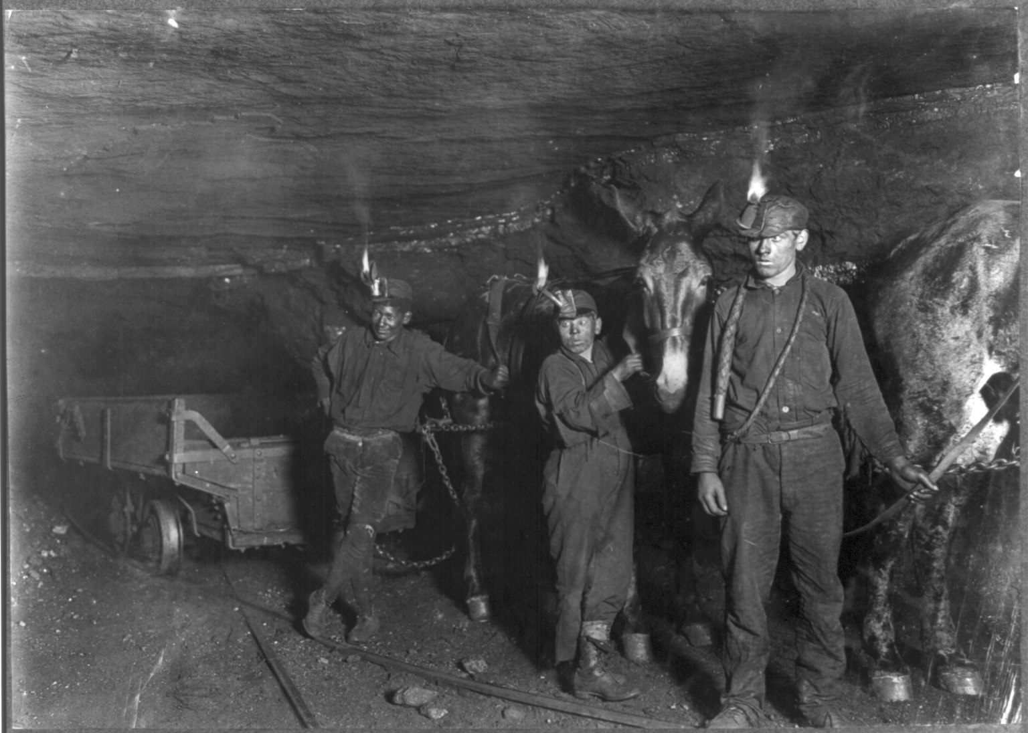
Underground Mine Fire Boss
      EARLY FIRE BOSS USED OPEN FLAME TO DETECT AND IGNITE METHANE GAS

Slide 4
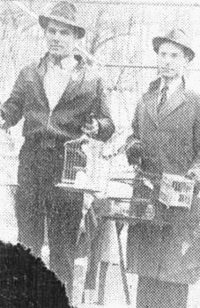
Later, a Canary was used for
Methane, Toxics, & Low Oxygen levels
A domestic canary, of this type was historically used to detect gas in coal mines. When the bird died it was time to evacuate the mine. This method was used in Great Britain until 1986?!?!?!?

Slide 5
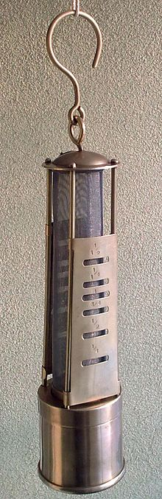
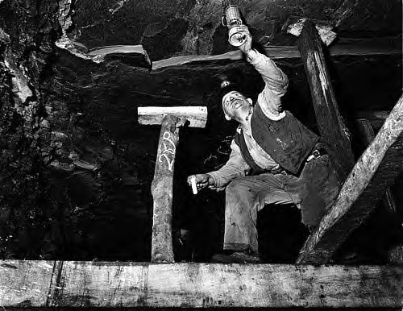
Flame Safety Lamp
Davy lamp was introduced for mining in 1815

Slide 6
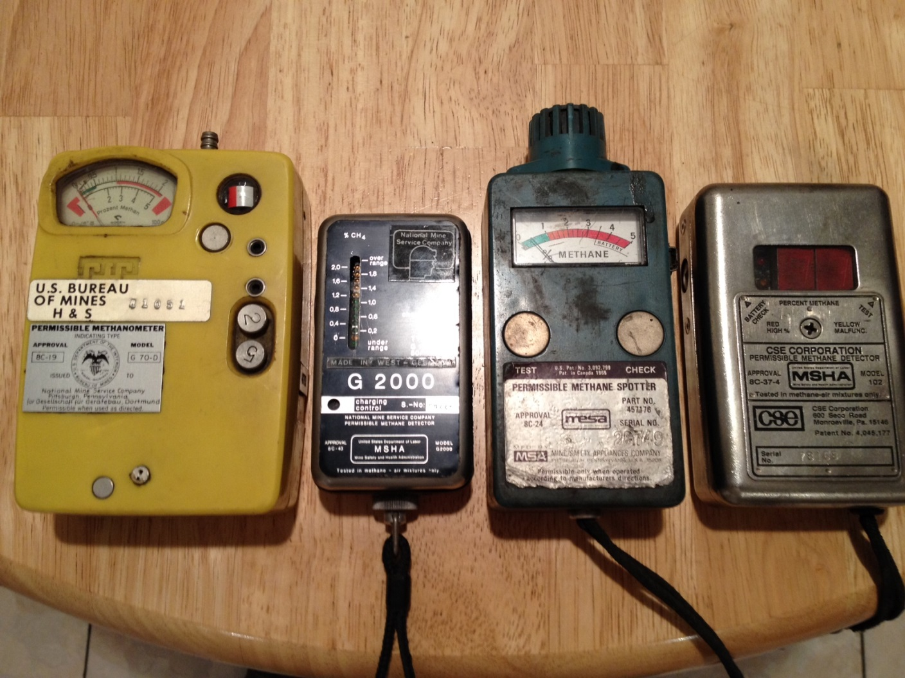
20th Century First Explosive Meters
It took until almost the mid-1900’s before reliable portable hand-held electronic gas detection was available.

Slide 7
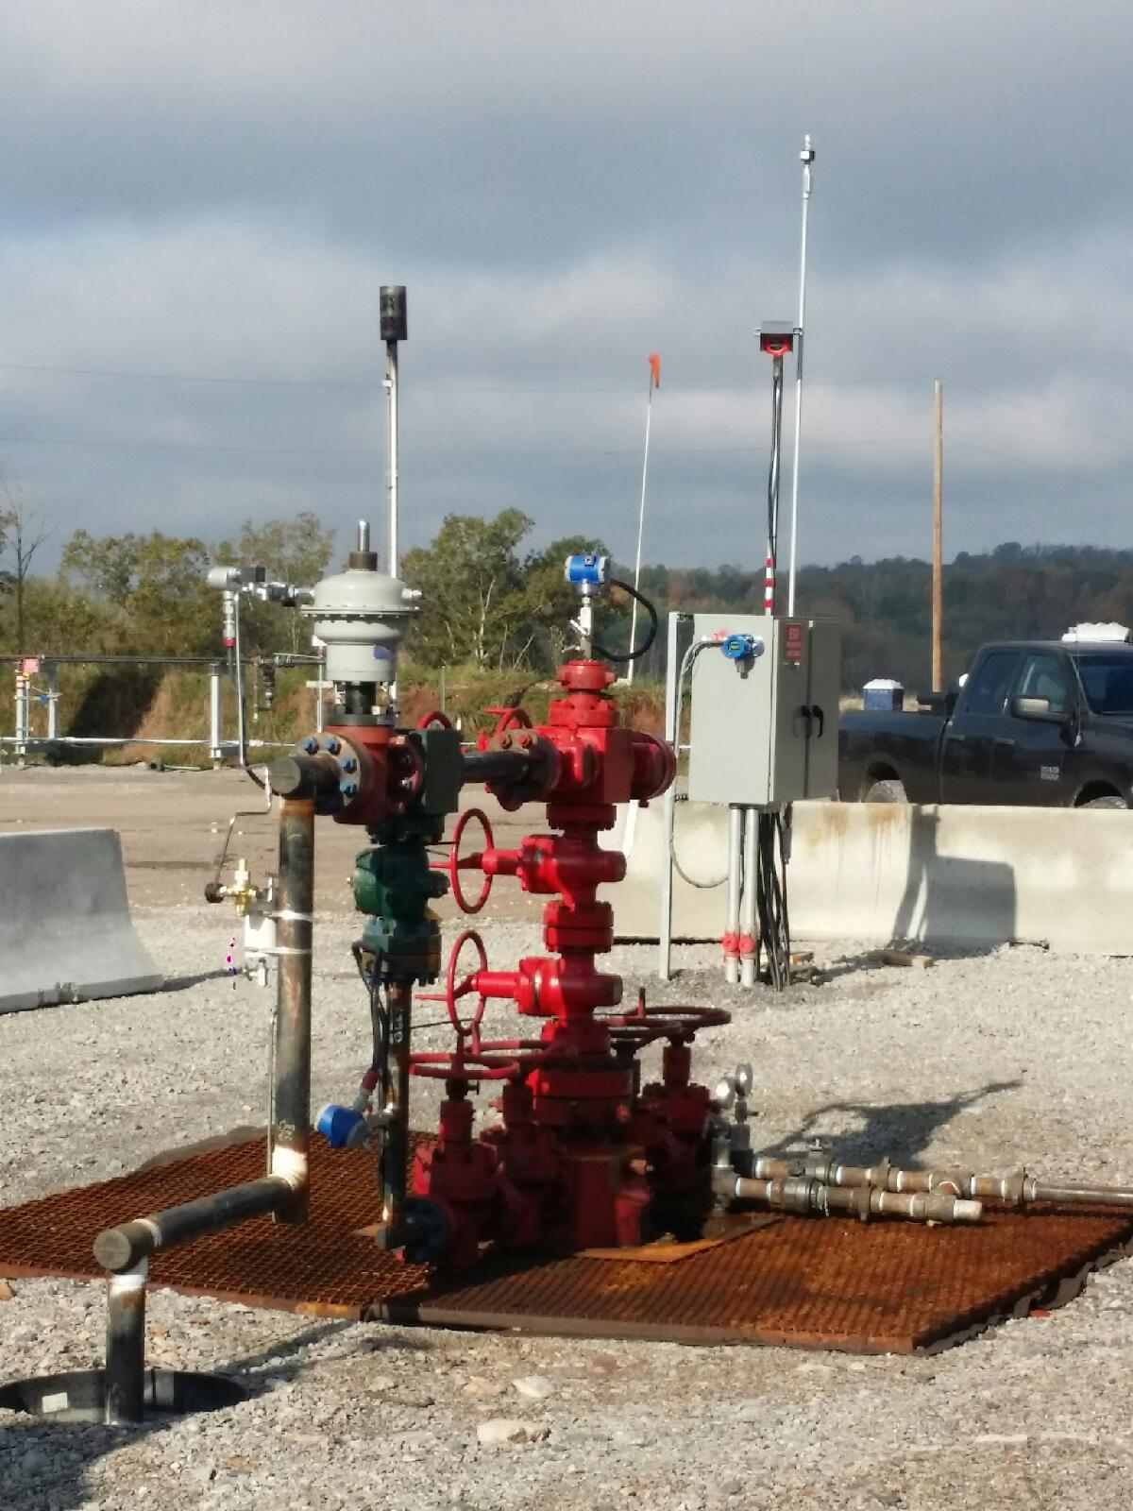
1970’s Introduced the First Fixed Explosive Gas Meters
LEL Fixed

Slide 8
Agenda
Hazardous Gas Awareness
  A review of the basics for Oxygen, Combustibles, and Toxic gases
Selecting the Right Tool for the Job
  Sensor Technology and Limitations
  Environmental Considerations
  Personnel or Area Monitoring Considerations

Slide 9
Acronyms
LEL Lower Explosive Limit - % LEL
UEL Upper Explosive Limit
PPM Parts Per Million - toxic gas measurement
PEL Permissible Exposure Limit - 8 hr/day - 40 hrs/wk - (OSHA)
TWA Time Weighted Average - 8hr/day
STEL Short Term Exposure Limit -15 mins/4x shift
IDLH Immediately Dangerous to Life and Health - 30 mins

Slide 10
COMBUSTIBLE
ATMOSPHERES
Account for 29% of the Deaths

Slide 11
Fire Triangle
Gas instruments:
Detect Oxygen level (air)
Detect the Combustible Gas (fuel)
fuel
air
Are either X.P. or I.S.
(not source of ignition)
source of ignition
Notes:
Q: What is the difference between explosion proof and intrinsically safe?
A: Explosion proof - means can cause an explosion (combustion) yet will contain same
Intrinsic Safety - will not cause explosion (combustion) to take place

Slide 12
Common Combustible Gases
LEL
Methane (natural gas) 5.0% vol
Ethane 3.0% vol
Propane 2.1% vol
Pentane (gasoline) 1.4% vol
Butane 1.9% vol
Hexane 1.2% vol
Methanol 6.0% vol
Hydrogen 4.0% vol

Slide 13
TOXIC GASES
Account for 21% of the Deaths

Slide 14
Toxic Gases
Toxic gases are compounds of elements that pose a threat to human life - react in the body in a poisonous fashion
Toxic gases can enter the body through various ways, they can be inhaled, ingested, injected, or absorbed through the skin
Toxic gases are often colorless and odorless making them a serious threat in the working environment
The two most common toxic gases are…
  Carbon Monoxide Hydrogen Sulfide

Slide 15
Carbon Monoxide Data
Colorless, Odorless, byproduct of incomplete combustion
Hazard: Flammable, LEL 12.5%
Health: Very Toxic (can be absorbed 200-300 times faster than oxygen by the hemoglobin)
Exposures: PEL/TWA 50ppm OSHA 35ppm NIOSH
  STEL 400ppm IDLH 1200ppm
Industries : Steel mills, Oil & Gas, General Industries, Mines

Slide 16
Effects of Carbon Monoxide (CO)
35ppm Default Instrument Alarm
50 ppm Permissible exposure limit, 8 hr
400ppm Frontal headache in 2-3 hrs
1600ppm Headache and nausea 20 mins Collapse and death in 1-2 hrs
6400ppm Headache, dizziness in 1-2 mins, unconsciousness and death in 10-15 mins
1% volume = 10,000ppm
Notes:
Demonstrate conversion formula --- ppm to %vol
example: “I tested the Oxygen Level, so I can enter safely, right??
CO O2
6400 ppm Reading 20.3%
35 ppm Low Alarm 19.5%
70 ppm High Alarm 23.5%
1,000,000 ppm = 100%vol 20.954% = content of oxygen in air
10,000 ppm = 1%vol - .64 % = %vol of CO at 6400 PPM
CO - 6400 ppm = .64%vol 20.314% = Oxygen level in space
Even though Oxygen Level is within tolerance, DOES NOT mean the space is free of combustible or toxic gases.

Slide 17
Effects of Carbon Monoxide
Has a half-life in the human body of 4 ½ to 6 hours
Will remain in the body for up to 36 hours
The average person exposed to 400 ppm after 15 minutes, will experience the symptoms of Carbon Monoxide poisoning.

Slide 18

Hydrogen Sulfide Data
H₂S Colorless, Rotten egg smell
Hazard: Flammable, LEL 4.0%
Health: Extremely Toxic, appears naturally from decomposition, reacts with the enzymes in the blood - inhibits cell respiration
Exposure: PEL/TWA 10ppm STEL 15ppm IDLH 100ppm
Industries: Oil and Gas, pulp and paper,
waste water treatment
Notes:
A: 15 min exposure / 4 x day w/ 1 hour break recommended between exposures.
Story: “BLACK SWAMP WATER”
contractor refuse to wear gas monitoring
employer splash in water - equipment alarms

Slide 19
Effects of H₂S
.13ppm Minimal perceptible odor
10ppm Beginning of eye irritation, permissible exposure limit
100ppm Coughing, eye irritation, loss of sense of smell
after 2-5 minutes
500ppm Loss of consciousness and possible death 30 mins - 1 hr
Quick Fact: Less than 2% of Human Flatulance is H2S!!!
Notes:
never trust olfactory senses (sense of smell) - prolonged exposure to gas renders sense of smell inoperative

Slide 20
The Right Tool for the Right Job
Anyone responsible for specification or design of
a gas detection system is aware of the difficulties,
challenges and concerns in selecting the correct technology
Define the compound gases present and potential exposure levels
Potential Cross Sensitivity to other background gases– false alarms

Slide 21
The Right Tool for the Right Job
Wide range of operating temperatures and environments
Determine the Type and Number of sensors - Selecting the best Instruments for the application
System Support, (Training, Startup & Commissioning, ease of calibration and product support)
Because of these and other conditions not one sensor type or manufacturer is suitable for all applications. It is important to select the best technology and support for your specific application.

Slide 22
Not all environments are created equal…
The Key to Instrument Selection
The key to selecting the right Instrument and Sensor type for the application is to:
Understand the environmental factors for each monitoring location
Investigate and identify all your detection requirements

Slide 23
Not all environments are created equal
The Key to Instrument Selection
Some Other Key Factors Include:
Temperature range of the application
Ventilation and gas densities being monitored
Instrument type and Sensor selection / Portable or Fixed
Detection range required for each sensor type
Monitoring duration required or desired.
Personnel or Process Protection
Background gases present>…
(cleaning solvents, process gases, and any other compounds that might adversely affect the sensor performance)

